Slide 1
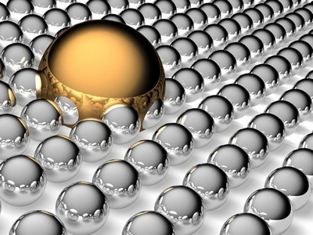
SURFACE CHEMISTRY

Slide 2
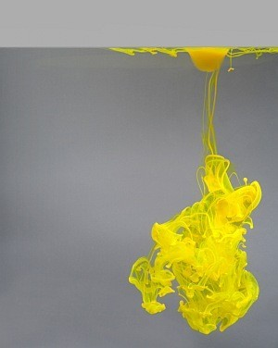

Slide 3
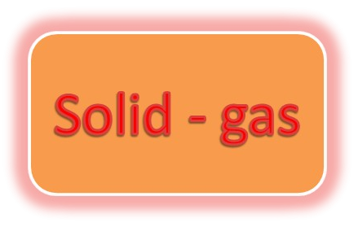


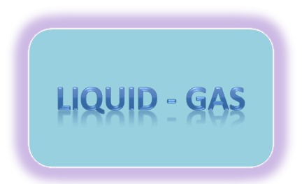
INTRODUCTION
Surface chemistry is the study of processes that occur at the interface of two bulk phases.
The bulk phases can be of the type :
Liquid - liquid

Slide 4
TYPES
ADSORPTION: is the adhesion of atoms, ions, biomolecules or molecules of gas, liquid, or dissolved solids to a surface.
ABSORPTION: is a physical or chemical phenomenon or a process in which atoms, molecules, or ions enter some bulk phase - gas, liquid, or solid material.

Slide 5
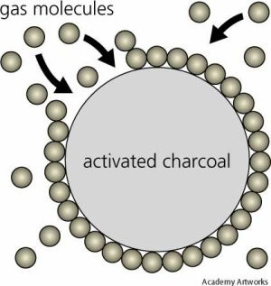
Adsorption on activated charcoal.

Slide 6
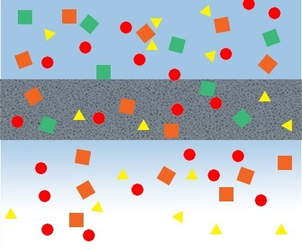
Absorption through a membrane

Slide 7

Adsorption
Adsorbate
Adsorbent
Absorption (“partitioning”)
PHASE I
PHASE 2

Slide 8
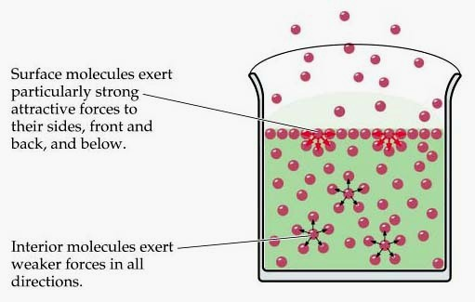

Slide 9
Adsorption
The accumulation of molecular species at the surface rather than in the bulk of a solid or liquid is termed adsorption .
The molecular species or substance, which concentrates or accumulates at the surface is termed adsorbate and the material on the surface of which the adsorption takes place is called adsorbent.

Slide 10
Action of adsorption
(i) If a gas like O₂, H₂, CO, Cl₂, NH₃ or SO₂ is taken in a closed vessel containing powdered charcoal, it is observed that the pressure of the gas in the enclosed vessel decreases. The gas molecules concentrate at the surface of the charcoal, i.e., gases are adsorbed at the surface.
(ii) In a solution of an organic dye, say methylene blue, when animal charcoal is added and the solution is well shaken, it is observed that the filtrate turns colourless. The molecules of the dye, thus, accumulate on the surface of charcoal, i.e., are adsorbed.
(iii) Aqueous solution of raw sugar, when passed over beds of animal charcoal, becomes colourless as the colouring substances are adsorbed by the charcoal.
(iv) The air becomes dry in the presence of silica gel because the water molecules
get adsorbed on the surface of the gel.
The process of removing an adsorbed substance from a surface on which it is adsorbed is called desorption.

Slide 11
Difference between adsoprtion and absorption
In adsorption, the substance is concentrated only at the surface and does not penetrate through the surface to the bulk of the adsorbent, while in absorption the substance is uniformly distributed throughout the bulk of the solid.
A distinction can be made between absorption and adsorption by taking an example of water vapour. Water vapours are absorbed by anhydrous calcium chloride but adsorbed by silica gel.
In other words, in adsorption the concentration of the adsorbate increases only at the surface of the adsorbent, while in absorption the concentration is uniform throughout the bulk of the solid.
Both adsorption and absorption can take place simultaneously also.
The term sorption is used to describe both the processes.

Slide 12
Mechanism of adsoprtion
Inside the adsorbent all the forces acting between the particles are mutually balanced but on the surface the particles are not surrounded by atoms or molecules of their kind on all sides, and hence they possess unbalanced or residual attractive forces.
These forces of the adsorbent are responsible for attracting the adsorbate particles on its surface. The extent of adsorption increases with the increase of surface area per unit mass of the adsorbent at a given temperature and pressure.

Slide 13
Another important factor featuring adsorption is the heat of adsorption. During adsorption, there is always a decrease in residual forces of the surface, i.e., there is decrease in surface energy which appears as heat.
Adsorption, therefore, is invariably an exothermic process. In other words, ∆H of adsorption is always negative. When a gas is adsorbed, the freedom of movement of its molecules become restricted. This amounts to decrease in the entropy of the gas after adsorption, i.e., ∆S is negative.
Adsorption is thus accompanied by decrease in enthalpy as well as decrease in entropy of the system. For a process to be spontaneous, the thermodynamic requirement is that, at constant temperature and pressure,
∆G must be negative, i.e., there is a decrease in Gibbs energy.
On the basis of equation, ∆G = ∆H – T∆S, ∆G can be negative if ∆H has sufficiently high negative value as – T∆S is positive. Thus, in an adsorption process, which is spontaneous, a combination of these two factors makes ∆G negative.As the adsorption proceeds, ∆H becomes less and less negative ultimately ∆H becomes equal to T∆S and ∆G becomes zero. At this state equilibrium is attained.

Slide 14
Types of adsorption
There are mainly two types of adsorption of gases on solids. If accumulation of gas on the surface of a solid occurs on account of weak van der Waals’ forces, the adsorption is termed as physical adsorption or physisorption.
When the gas molecules or atoms are held to the solid surface by chemical
bonds, the adsorption is termed chemical adsorption or chemisorption.
The chemical bonds may be covalent or ionic in nature. Chemisorption involves a high energy of activation and is, therefore, often referred to as activated adsorption.
Sometimes these two processes occur simultaneously and it is not easy to ascertain the type of adsorption. A physical adsorption at low temperature may pass into chemisorption as the temperature is increased. For example, dihydrogen is first adsorbed on nickel by van der Waals’ forces.
Molecules of hydrogen then dissociate to form hydrogen atoms which are held on the surface by chemisorption.

Slide 15
Characteristics of physisorption
(i) Lack of specificity: A given surface of an adsorbent does not show any preference for a particular gas as the van der Waals’ forces are universal.
(ii) Nature of adsorbate: The amount of gas adsorbed by a solid depends on the nature of gas. In general, easily liquefiable gases (i.e., with higher critical temperatures) are
readily adsorbed as van der Waals’ forces are stronger near the critical temperatures.
(iii) Reversible nature: Physical adsorption of a gas by a solid is generally reversible. Thus, More of gas is adsorbed when pressure is increased as the volume of the gas decreases and the gas can be removed by decreasing pressure. Since the adsorption process is exothermic, the physical adsorption occurs readily at low temperature and decreases with increasing temperature (Le-Chatelier’s principle).
(iv) Surface area of adsorbent: The extent of adsorption increases with the increase of surface area of the adsorbent. Thus, finely divided metals and porous substances having large surface areas are good adsorbents.
(v) Enthalpy of adsorption: No doubt, physical adsorption is an exothermic process but
its enthalpy of adsorption is quite low (20– 40 kJ mol⁻¹). This is because the attraction
between gas molecules and solid surface is only due to weak van der Waals’ forces.

Slide 16
Characteristics of chemisorption
(i) High specificity: Chemisorption is highly specific and it will only occur if there is some possibility of chemical bonding between adsorbent and adsorbate.
(ii) Irreversibility: As chemisorption involves compound formation,
it is usually irreversible in nature.
- Chemisorption is also an exothermic process but the process is very slow at low temperatures on account of high energy of activation. Like most chemical changes, adsorption often increases with rise of temperature.
-Physisorption of a gas adsorbed at low temperature may change into chemisorption at a high temperature. Usually high pressure is also favourable for chemisorption.

Slide 17
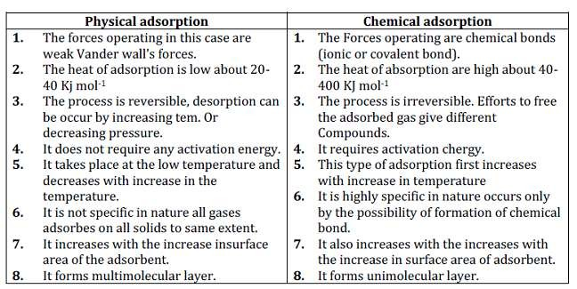
(iii) Surface area: Like physical adsorption, chemisorption also
increases with increase of surface area of the adsorbent.
(iv) Enthalpy of adsorption: Enthalpy of chemisorption is high (80-240 kJ mol-1) as it involves chemical bond formation.

Slide 18
Adsorption isotherms
The variation in the amount of gas adsorbed by the adsorbent with pressure at constant temperature can be expressed by means of a curve termed as adsorption isotherm.
Freundlich adsorption isotherm: Freundlich, in 1909, gave an empirical relationship between the quantity of gas adsorbed by unit mass of solid adsorbent and pressure at a particular temperature. The relationship can be expressed by the following equation:

Slide 19
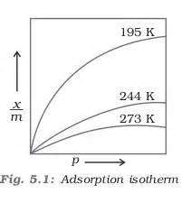
where x is the mass of the gas adsorbed on mass m of the adsorbent at pressure P, k and n are constants which depend on the nature of the adsorbent and the gas at a particular temperature.
The relationship is generally represented in the form of a curve where mass of the gas adsorbed per gram of the adsorbent is plotted against pressure .
These curves indicate that at a fixed pressure, there is a decrease in physical adsorption with increase in temperature. These curves always seem to approach saturation at high pressure.

Slide 20
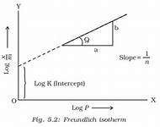

Taking log on both sides of equation we get
The validity of Freundlich isotherm can be verified by plotting log x/m on y-axis (ordinate) and log p on x-axis (abscissa).
If it comes to be a straight line, the Freundlich isotherm is valid, otherwise not . The slope of the straight line gives the value of 1/n . The intercept on the y- axis gives the value of log k.
Freundlich isotherm explains the behaviour of adsorption in an approximate manner. The factor 1 can have values between 0 and 1 . Thus, above equation holds good over a limited range of pressure.

Slide 21
When1/n = 0, x/m = constant, the adsorption is independent of pressure. nm
When 1/n = 1, x/m = k p, i.e. x ∝ p, the adsorption varies directly with pressure.
Both the conditions are supported by experimental results. The experimental isotherms always seem to approach saturation at high pressure.
This cannot be explained by Freundlich isotherm. Thus, it fails at high pressure.

Slide 22
Adsorption from solution phase
Solids can adsorb solutes from solutions also. When a solution of acetic acid in acetic acid is shaken with charcoal a part of it is adsorbed by charcoal and the concentration of the acid decreases in the solution. . The following observations have been made in the case of adsorption from solution phase:
(i) The extent of adsorption decreases with an increase in temperature.
(ii) The extent of adsorption increases with an increase of surface area of the adsorbent.
(iii) The extent of adsorption depends on the concentration of the solute
in solution.
(iv) The extent of adsorption depends on the nature of the adsorbent and
the adsorbate.

Slide 23
Freundlich’s equation approximately describes the behaviour of adsorption from solution with a difference that instead of pressure, concentration of the solution is taken into account, i.e.
Where C is the equilibrium concentration, i.e., when adsorption is
complete. On taking logarithm of the above equation, we have
Plotting log x/m against log C a straight line is obtained which shows the
validity of Freundlich isotherm.
This can be tested experimentally by taking solutions of different concentrations of acetic acid. Equal volumes of solutions are added to equal amounts of charcoal in different flasks.
The final concentration is determined in each flask after adsorption. The difference in the initial and final concentrations give the value of x. Using the above equation, validity of Freundlich isotherm can be established.

Slide 24
Applications of adsorption
(i) Production of high vacuum: The remaining traces of air can be adsorbed by charcoal from a vessel evacuated by a vacuum pump to give a very high vacuum.
(ii) Gas masks: Gas mask (a device which consists of activated charcoal or mixture of adsorbents) is usually used for breathing in coal mines to adsorb poisonous gases.
(iii) Control of humidity: Silica and aluminium gels are used as adsorbents for removing moisture and controlling humidity.

Slide 25
(iv) Removal of colouring matter from solutions: Animal charcoal removes colours of solutions by adsorbing coloured impurities.
(v) Heterogeneous catalysis: Adsorption of reactants on the solid surface of the catalysts increases the rate of reaction. There are many gaseous reactions of industrial importance involving solid catalysts.
(vi) Separation of inert gases: Due to the difference in degree of adsorption of gases by charcoal, a mixture of noble gases can be separated by adsorption on coconut charcoal at different temperatures.
(vii) In curing diseases: A number of drugs are used to kill germs by getting adsorbed on them.
(viii) Froth floatation process: A low grade sulphide ore is concentrated by separating it from silica and other earthy matter by this method using pine oil and frothing agent .
(ix) Adsorption indicators: Surfaces of certain precipitates such as silver halides have the property of adsorbing some dyes like eosin, fluorescein, etc. and thereby producing a characteristic colour at the end point.

Slide 26
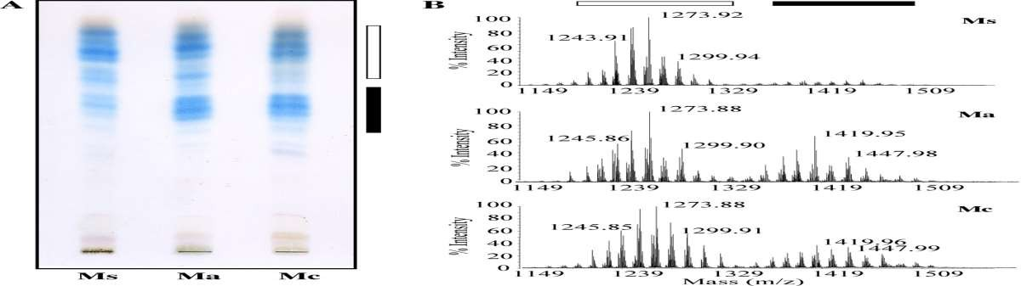
(x) Chromatographic analysis: Chromatographic analysis based on the phenomenon of adsorption finds a number of applications in analytical and industrial fields.

Slide 27
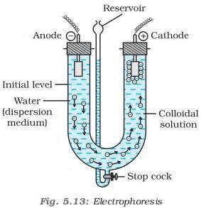
Electrophoresis
When electric potential is applied across two platinum electrodes dipping in a colloidal solution, the colloidal particles move towards one or the other electrode.
The movement of colloidal particles under an applied electric potential is called electrophoresis. Positively charged particles move towards the cathode while negatively charged particles move towards the anode
When electrophoresis that is.,movement of particles is prevented by some suitable means, it is observed that the dispersion medium begins to move in an electric field. This phenomenon is termed electroosmosis.

Slide 28
Thank You

